Slide 1

Collision avoidance simulator in autonomous driving PROJECT SOFTWARE-DEFINED COMMUNICATION SYSTEMS
Umberto Pirovano - Andrea Conese - Andrea Paternò - Hamze Ghorbani Koujani
V0 presentation

Slide 2

ACCOMPLISHED GOALS
Version 0
Identifying requirements and tools setup
Urban scenario modeling
CV model integration
Development environment setup
Windows / Linux
Python
Conda
AirSim setup
Scenario selection & API installation
Moving the car
Storing the images
Computer Vision
Research of models and datasets
Comparing different CV models
Integration of the chosen solution

Slide 3
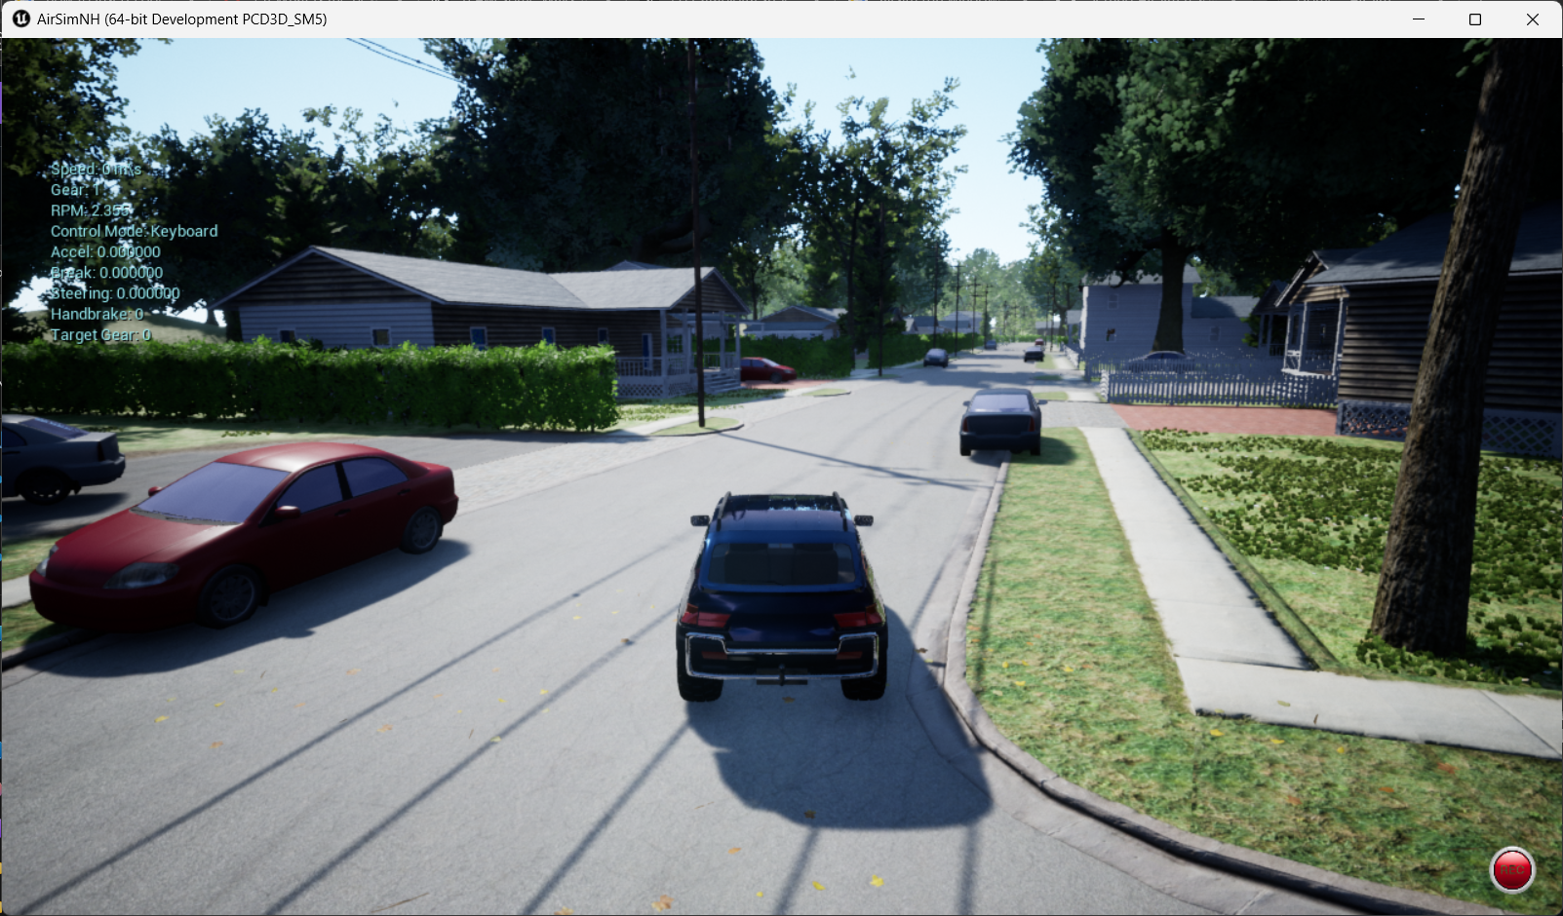
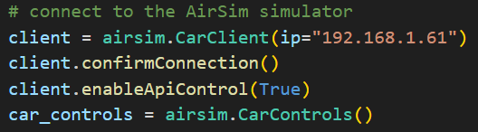

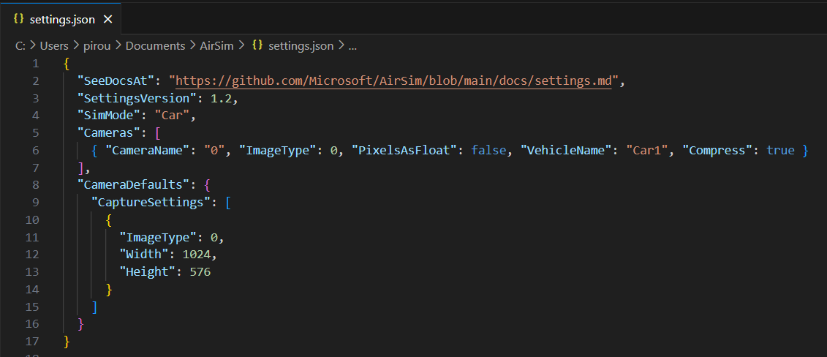
AIRSIM SETUP

Slide 4
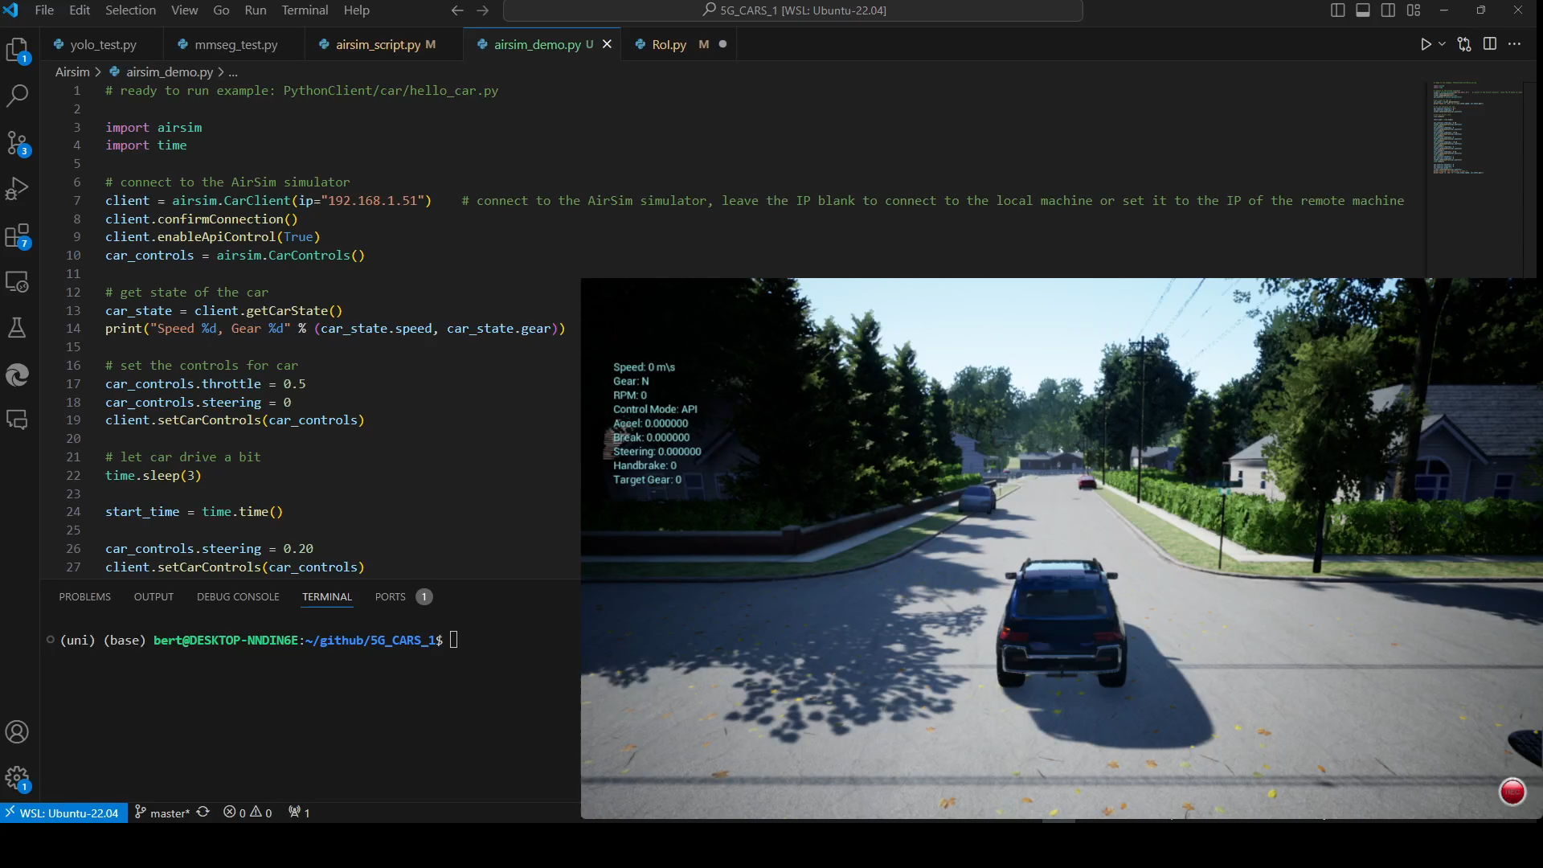

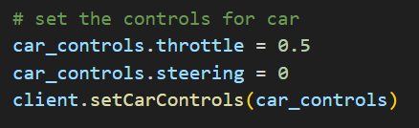

CONTROLLING THE CAR & STORING THE IMAGES
Temporary solution
CV model

Slide 5
MODEL COMPARISON
CV MODELS | TASK | DATASET | EXECUTION TIME (seconds)* (one image)
YoloV8-m | Object detection | COCO | 0.012
MMDetection Faster R-CNN | Object detection | Cityscapes | 0.763
MMSegmentation DeepLabV3+ | Image segmentation | Cityscapes | 1.807
HARDWARE TESTED: NVIDIA RTX 2060 MOBILE (6 GB VRAM), CUDA 12.4

Slide 6
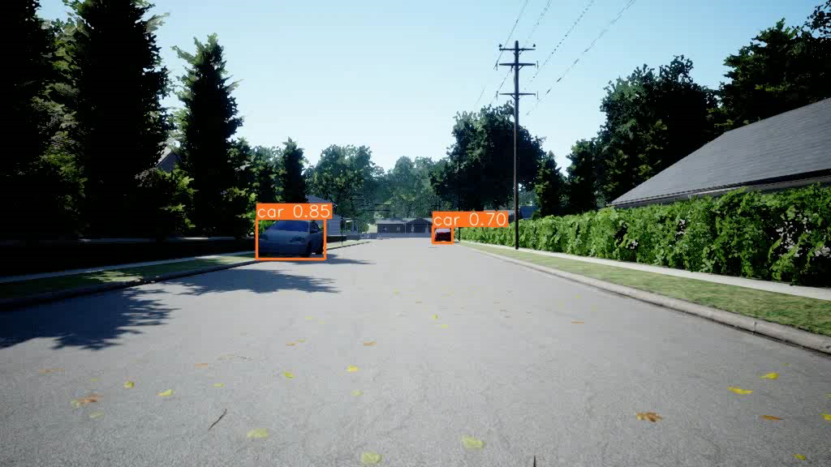
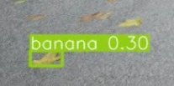
YOLO V8
PROBLEMS: mislabeled or non-detected objects

Slide 7
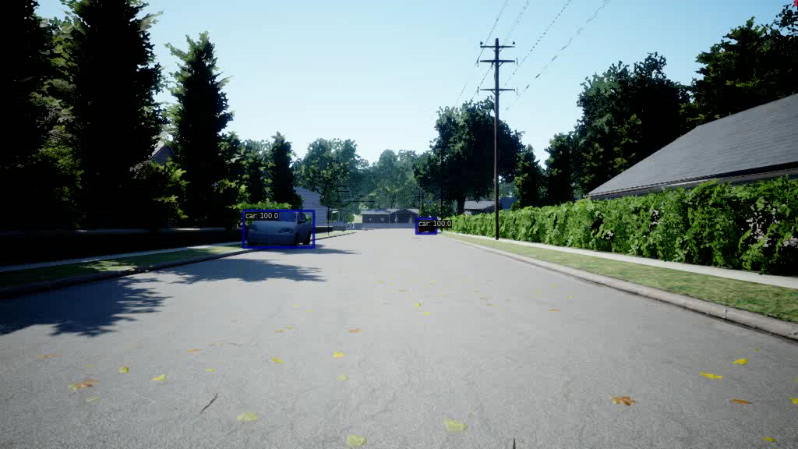
MMDetection – Faster R-CNN
PROBLEMS: non-detected objects

Slide 8
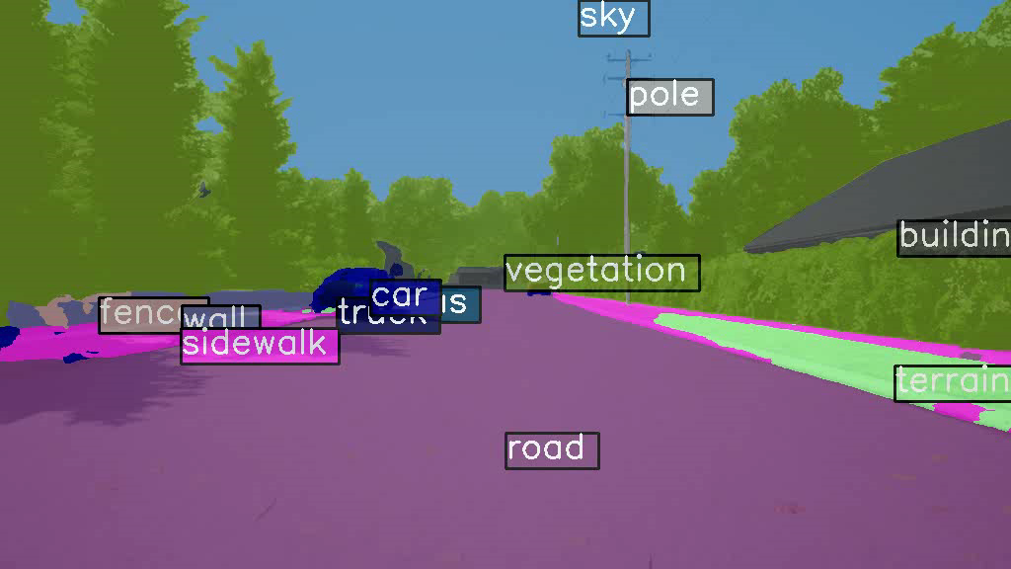
MMSegmentation – DeepLabV3+
ADVANTAGES: all possible obstacles are labeled, pixel-wise label

Slide 9
CONCLUSIONS
CHALLENGES
ACTIVATE CAR SENSORS
CONTROLLING THE CAR & STORING THE IMAGES
CV TASK & DATASET
SOLUTIONS
AIRSIM’S DOCUMENTATION + settings.json
AIRSIM API
CITYSCAPES DATASET + IMAGE SEGMENTATION

Slide 10
Gantt Chart
TODAY
Initiative | Objective | April 1 | April 2 | April 3 | April 4 | May 1 | May 2 | May 3 | May 4 | June 1 | June 2 | June 3 | June 4
Version 0 | Simulate the urban scenario in AirSim and achieve video frames.
 | Prepare the data and feed it to the CV model and detecting objects.
 | Basic results’ analysis
Version 1 | Measure the distance from detected objects. Providing steering and speed change information.
 | Establish a IEEE 802.11ax channel simulator, transmitting images from airsim to CV model.
 | Refine the channel simulator to send steering data back to theAirsim. Integrate the whole project.
 | Results’ analysis and evaluation
Version 2 | Develop GUI for the final project. Prepare detailed reports.

Slide 11

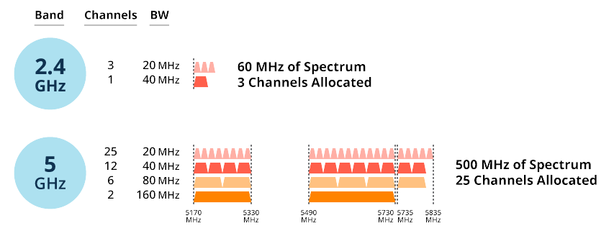
… NEXT STEPS
Version 1
Wireless channel simulator establishment
Path logic development
Results’ analysis
System assessment based on KPIs
ABSTRACTED

Slide 12
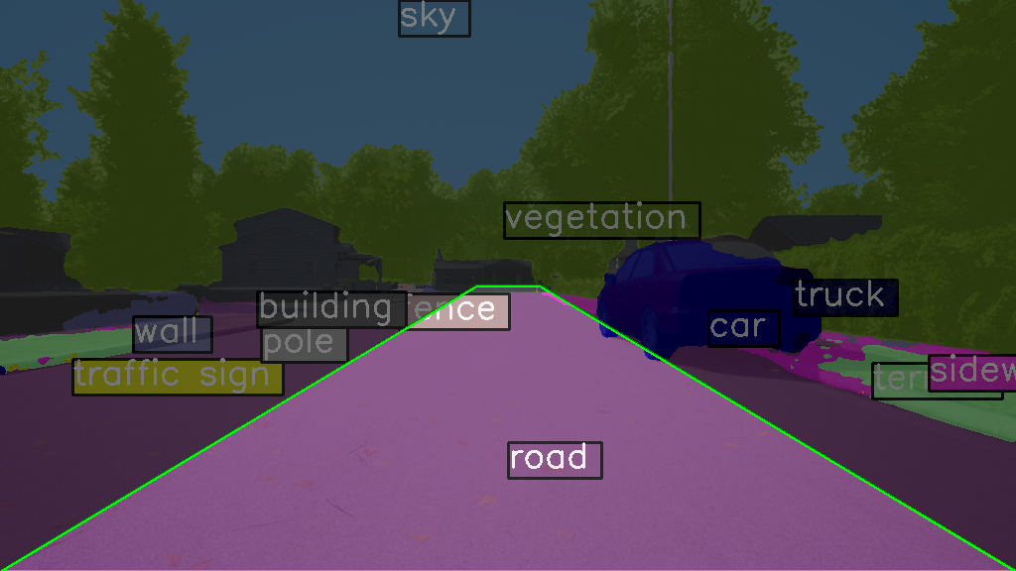
… NEXT STEPS
Version 1
Wireless channel simulator establishment
Path logic development
Results’ analysis
System assessment based on KPIs
Define a Region Of Interest (ROI)

